Slide 1
Digital Habit vs. Mental Health
Oluwadamilola Aworinde

Slide 2
Table of content
Objective
Background
Observation
Insights
Recommendations
Conclusion

Slide 3
Objective
This analysis aims to explore how the intensity of screen time and social media engagement, especially TikTok usage, correlates with key indicators of well-being such as sleep hours, perceived stress levels, and mood scores.

Slide 4
Background
As screen time and social media use rise, concerns grow about their effects on sleep, stress, and mood. Platforms like TikTok are especially popular, but their impact on well-being is not fully understood.
This study explores how digital habits—particularly screen time and TikTok use—relate to sleep duration, stress levels, and mood, providing insights into the balance between digital engagement and mental health.
Tool used: Python
Data source: https://www.kaggle.com/datasets/abhishekdave9/digital-habits-vs-mental-health-dataset

Slide 5
Observation
High Screen Time: On average, users spend about 6 hours daily on screens, with TikTok alone consuming over 2 hours, indicating heavy digital engagement.
TikTok Usage & Mood/Stress: There is a moderate positive correlation between TikTok use and stress levels, and a moderate negative correlation with mood, suggesting that increased TikTok use may be linked to emotional strain.
Sleep & Well-being: Sleep hours are strongly negatively correlated with stress and strongly positively correlated with mood. This implies that more sleep supports better mood and reduces stress.
Screen Time & Mood: More screen time is associated with higher stress and lower mood, though it does not significantly affect sleep hours directly.
Social Media Platforms: The number of platforms used shows no meaningful relationship with sleep, mood, or stress, indicating that platform variety matters less than time spent.

Slide 6
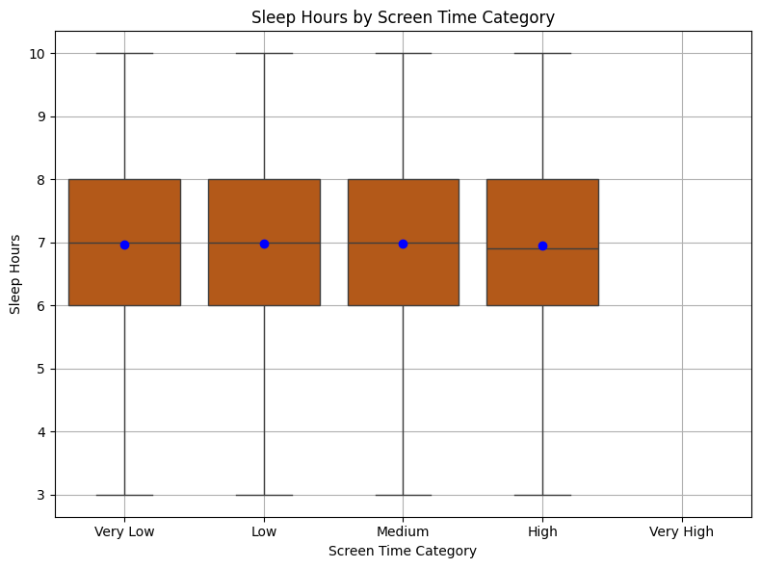
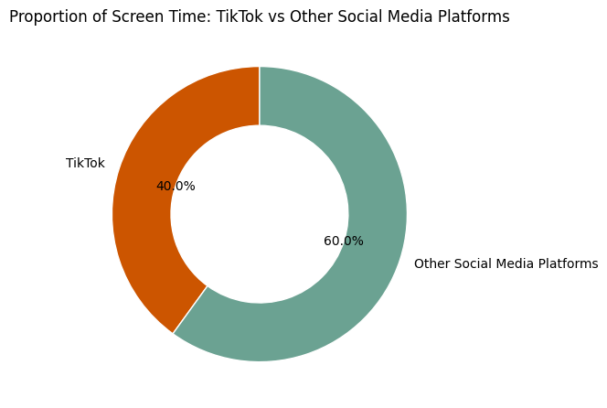
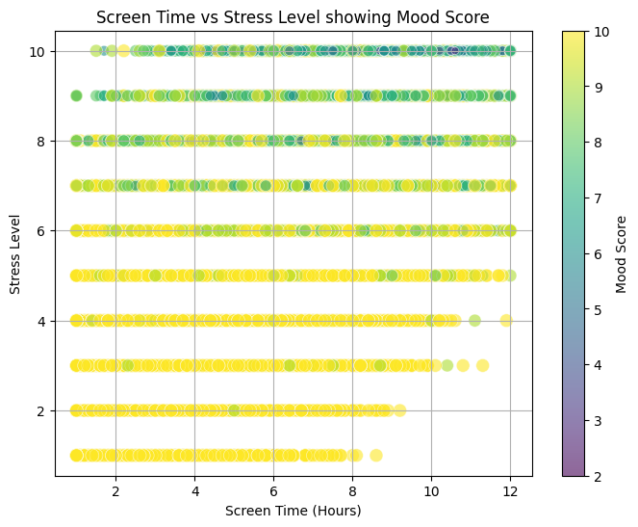
Insights
TikTok has 40% of the total screentime.
Sleep hours across all groups generally range from 3 to 10 hours.
Most users sleep between 6 and 8hours. There may be very short or very long sleepers, but the main distribution is fairly stable.
Very Low, Low, and Medium screen time users have a median around 7 hours of sleep while High and Very High screen time users have a slightly lower median (~6.8–6.9 hours).
Screen time (Hours) has a positive correlation with stress level, meaning that as screen time increases, stress level tends to increase.
Mood score has a negative correlation with stress level, indicating that higher mood scores are associated with lower stress levels.

Slide 7
Recommendations
Educate on Digital Well-being: Awareness campaigns and educational programs can help users understand the impact of screen behavior on mental health and provide strategies for healthier digital habits.
Focus on Quality, Not Quantity of Platforms: As the number of social media platforms used doesn't strongly affect well-being, emphasis should shift from limiting platforms to managing time spent and the type of content consumed.
Implement Digital Detox Intervals: Individuals and institutions (e.g., schools or workplaces) can promote short daily or weekly screen breaks to refresh focus and reduce digital fatigue.

Slide 8
Conclusion
The analysis shows that while screen time doesn't seem to impact sleep hours directly in this dataset, it does correlate with higher stress and lower mood, both of which in turn have strong correlations with sleep. In other words, screen time may be affecting sleep indirectly through stress.
These insights underscore the importance of managing daily screen time to promote better sleep health. Further studies could explore underlying factors such as device usage before bedtime and the role of screen content to develop targeted recommendations for improving sleep hygiene.

